Slide 1
HANOI UNIVERSITY OF SCIENCE AND TECHNOLOGY
ISOLATION, SCREENING AND THE INFLUENCE OF CULTIVATION FACTORS ON CELLULASE OF BATERIA ISOLATED FROM TERMITES GUT
Le Thanh Ha

Slide 2
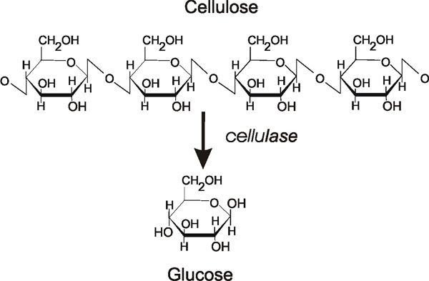
1. OVERVIEW
Enzyme cellulase:
Endocellulase (CMCase).
Exocellulase.
β-glucosidase.

Slide 3
Termites - the most important lignocellulose-digesting insects
Table 1.1. Isolated cellulolytic bacteria from termites gut
Isolates | Enzyme | Source
Acinetobacter sp. | EG, FP | Microcerotermes diversus
Acinetobacter sp. | EG, βG | Coptotermes curvignathus
Bacillus cereus | EG, FP | Zootermopsis angusticollis
Bacillus cereus | EG | Reticulitermes hesperus
Bacillus megaterium | EG, FP | Zootermopsis angusticollis
Bacillus sp. | βG, αA | Reticulitermes santonensis
Bacillus sp. | CBH, βG, EG | Reticulitermes speratus

Slide 4
2. MATERIALS AND METHODS
Endoglucanase (CMCase) activity
FP activity

Slide 5
MEDIA
M1
- NaNO₃ : 2.5g/l.
K₂HPO₄ : 1g/l.
MgSO₄: 0.5g/l.
KCl : 2g/l.
Peptone : 2g/l.
CMC : 5g/l.
pH: 6.8-7.2
M2
Peptone: 10g/l.
NaCl : 10g/l.
Cao nấm men: 5g/l.
CMC: 5g/l.
pH: 6.8-7.2
M3
Cám gạo: 20g/l.
Casein : 10g/l.
Bột đậu nành: 10g/l.
NaCl: 1g/l.
pH: 6.8 - 7.2

Slide 6
3. RESULTS
3.1. Isolation, screening and idenfication of cellulolytic bacteria
Table 3.1. Hydrolytic capacity and cellulase activity of isolates
Isolates | Hydrolytic capacity (D/d) | CMCase (U/ml) | FPase (U/ml)
CM2-4 | 2.4 | 0.097 | 0.027
CG2 | 0.8 | 0.025 | 0.020
CG4 | 2.4 | 0.034 | 0.023
CG4-1-2 | 2.3 | 0.047 | 0.024
D1-3 | 1.7 | 0.038 | 0.018
D1-7 | 1.4 | 0.037 | 0.023
D1-8 | 0.8 | 0.027 | 0.017
D1-12 | 3.8 | 0.064 | 0.023
T2-11 | 8.0 | 0.150 | 0.041
TM1-7-1 | 0.7 | 0.021 | 0.016
G4 | 10 | 0.286 | 0.026

Slide 7
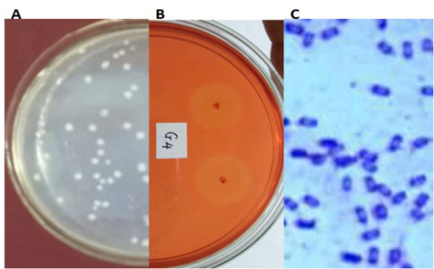
Fig. 3.1. Morphology of G4. Colony of G4 (A); Halo zone formed by G4 on CMC agar plate (B) Gram staining of G4 (C).

Slide 8
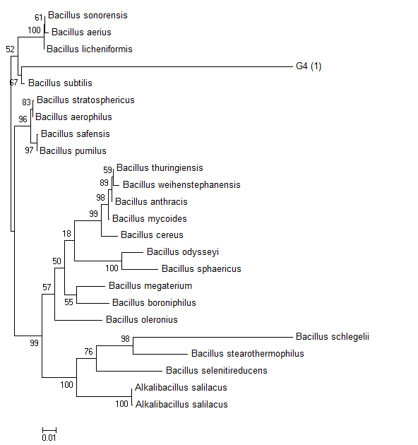
Figure 3.2. Phylogenetic tree of 16S rRNA genes of the genus Bacillus. The sequences used for comparison with the 16SrRNA gene of strain G4 were obtained from GenBank.

Slide 9
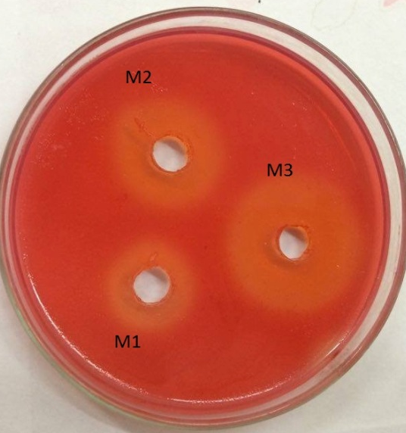
3. RESULTS
3.2. Effect of culture medium
Medium M3 was selected

Slide 10
3.3. Effect of agitation speed
Agitation speed of 150 rpm was selected

Slide 11
3.4. Effect of cultivation temperature
Temperature 37ºC was selected

Slide 12
3.5. Effect of initial pH medium
pH 7 was selected

Slide 13
4. CONCLUSION
From 11 isolated strain, isolate G4 was selected and was identified as Bacillus subtilis
Cultivation conditions: Initial pH 7, temperature 37ºC, agitation speed 150 rpm on M3 medium the CMCase reached 3.36 U/ml about 2-fold increase

Slide 14
REFERENCES
Mekar S. N., Saptarini W. I. - Isolation of cellulolyitc bacteria from termites of corn cobs as carbon source, International Journal of Pharmacy and Pharmaceutical Sciences 6 (4) (2014) 215-217.
Sharma D., Joshi B., Bhatt M. R., Joshi J., Malla R., Bhattarai T., and Sreerama L. -Isolation of Cellulolytic Organisms from the Gut Contents of Termites Native to Nepal and Their Utility in Saccharification and Fermentation of Lignocellulosic Biomass, Journal of Biomass to Biofuel 2 (2015) 11-20.
Sreena C. P. K R. N. and Sebastian. D. – Isolation and Characterization of Cellulase Producing Bacteria from the Gut of Termites (Odontotermes and Heterotermes Species), British Biotechnology Journal 9 (2015) 1-10.
Wenzel M., Schönig I., Berchtold M., Kämpfer P. and König H. - Aerobic and facultatively anaerobic cellulolytic bacteria from the gut of the termite Zootermopsis angusticollis, Journal of Applied Microbiology 92 (2002) 32-40.
...

Slide 15
A
B
C

